Slide 1
Chronic Kidney Disease (CKD) Detection using Machine Learning
Chronic kidney disease (CKD) poses a significant healthcare challenge due to its gradual progression and potential complications. Early detection is essential for effective management. This study explores the application of machine learning algorithms for improved CKD detection. We analyze various algorithms, including Support Vector Machine (SVM), Random Forest, Logistic Regression, and Artificial Neural Networks (ANNs), to classify patients with and without CKD based on features like bloodwork, vitals, and demographics. The study discusses the advantages of machine learning in CKD detection, including the potential for early diagnosis, improved accuracy, and risk stratification. We acknowledge the importance of high-quality data, interpretability of models, and generalizability for real-world application

Slide 2
Common Machine Learning Algorithms
Support Vector Machine (SVM)
https://www.kaggle.com/datasets/abhia1999/chronic-kidney-disease/data

Slide 3
Advantages
Early Detection: Machine learning models can identify patterns in patient data that might be missed by traditional methods, enabling earlier detection of CKD.
Improved Accuracy: By analyzing larger datasets, machine learning models can potentially achieve higher accuracy in CKD diagnosis compared to traditional methods.
Risk Stratification: Machine learning can help stratify patients based on their risk of developing CKD, allowing for targeted interventions and preventive measures.

Slide 4
Considerations
Generalizability:
Data Quality: The performance of machine learning models heavily relies on the quality and size of the training data.
Interpretability: While some models offer good accuracy, it can be challenging to understand how they arrive at a specific prediction. This is crucial in the medical field for ensuring trust and transparency.

Slide 5
Machine Learning for Chronic Kidney Disease Detection
Chronic kidney disease (CKD) is a growing global health concern. Early detection is crucial for effective management and preventing complications. Machine learning (ML) offers a promising approach for improved CKD detection by analyzing vast amounts of patient data and identifying patterns that might be missed by traditional methods.

Slide 6
Methodology
Feature Selection/Engineering: Relevant features are selected based on their importance in predicting CKD. New features may be created based on domain knowledge.
Data Collection: A dataset containing information about patients, including age, gender, medical history (diabetes, hypertension), and laboratory test results (creatinine levels, glomerular filtration rate), is obtained from healthcare records.
Data Preprocessing: The dataset is cleaned to handle missing values and encoded to prepare it for machine learning models. Numerical features are scaled to ensure uniformity.
Model Selection: Several machine learning models, such as Logistic Regression, Random Forest, Support Vector Machines (SVM), and Gradient Boosting Machines (GBM), are considered for CKD prediction.
Model Training: The dataset is split into training and testing sets. The selected models are trained on the training set using cross-validation to optimize performance.

Slide 7
Model Evaluation
Model Evaluation: The trained models are evaluated on the testing set using metrics like accuracy, precision, recall, and F1score to assess their performance in predicting CKD.Hyperparameter Tuning: The hyperparameters of the models are tuned using techniques like grid search or random search to improve their performance.Deployment: The bestperforming model is deployed in a production environment where it can be used to predict CKD in new patient data.
Monitoring and Maintenance: The deployed model is monitored for performance and updated as needed to maintain its accuracy and relevance.

Slide 8
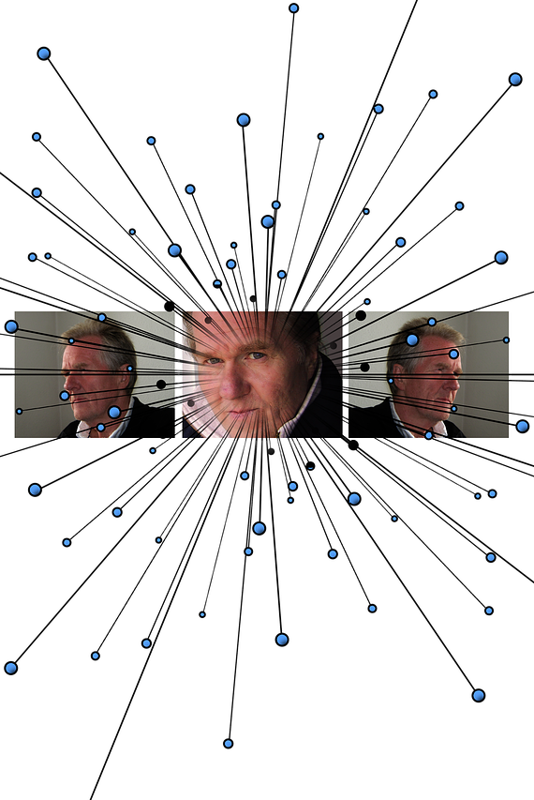
Literature Review
Algorithm Performance: Studies report promising results using algorithms like Support Vector Machine (SVM), Random Forest, Logistic Regression, and Artificial Neural Networks (ANNs). Accuracy in CKD prediction often exceeds 0.9 [1, 2, 3].

Slide 9
Thank you. Please feel free to ask any questions. 😄

